Slide 1
Hobby Project
Andrei Ionita

Slide 2
Project Description
Create a Character Management system for D&D characters
CRUD controls for players/user and the characters they create
HTML
History:
Understanding the code
Getting used to Spring, Bean, HTML, JS
Following an Agile methodology
Creating unit tests and the functionality
Trial and Error

Slide 3
Technologies used
Source control – Git
Agile Management – Jira
Database Construction – MySQL
Programming language – Java (+ Junit - testing), HTML
Automation Tool – Maven
Technology – Spring, Bean

Slide 4
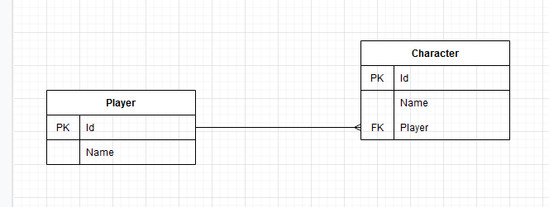
Current ERD

Slide 5
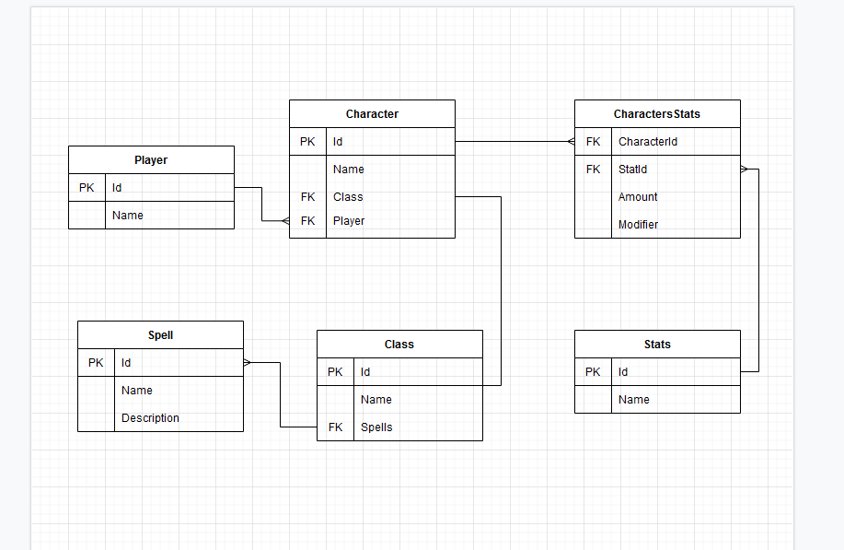
Future ERD

Slide 6
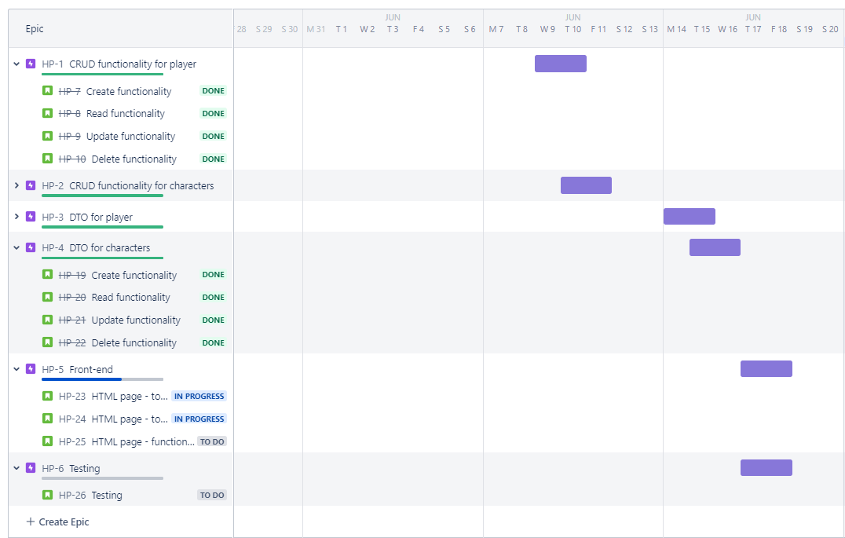
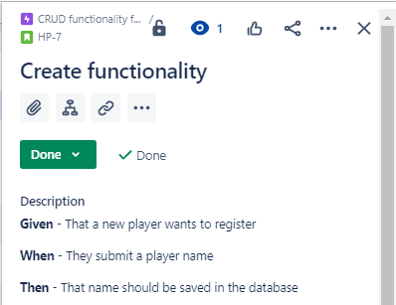
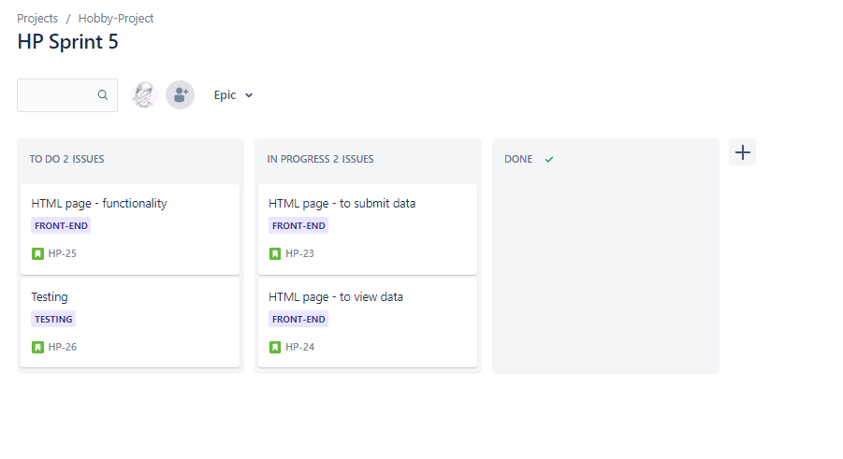
Jira Board

Slide 7
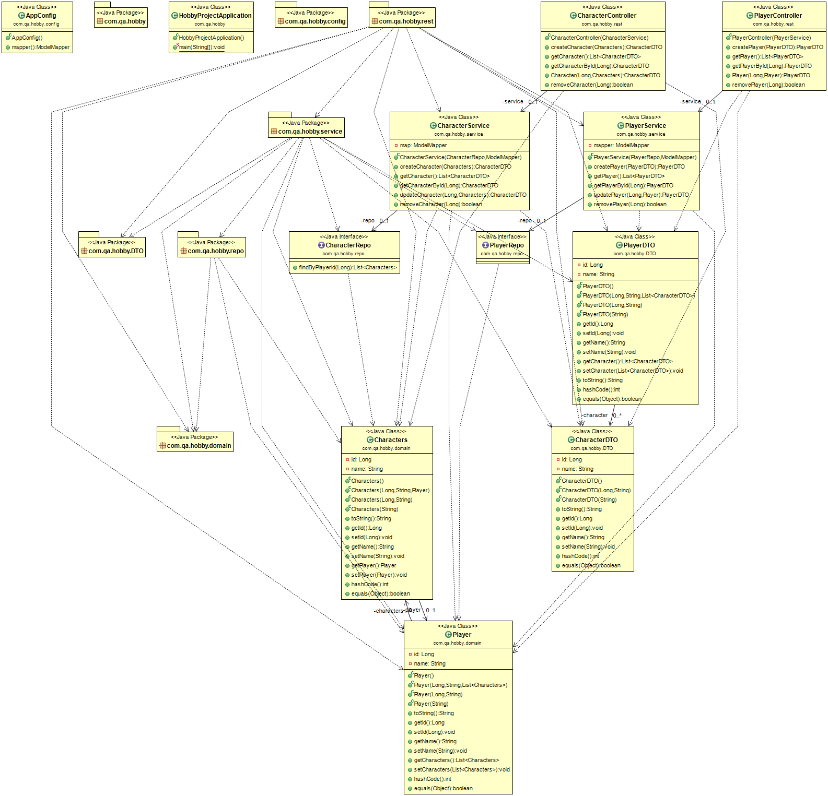
UML Diagram

Slide 8
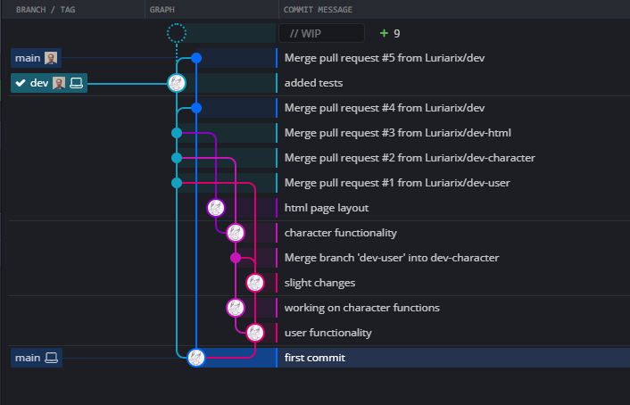
Source Control

Slide 9
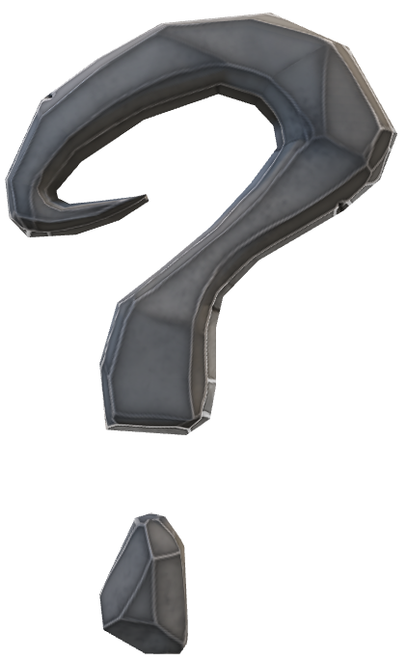
Questions

